Slide 1
BOOK REVIEWS WEBSITE Here you will find any piece of information about any book you want to read.
<q>“A reader lives a thousand lives before he dies.” – George R. R. Martin </q>

Slide 2
PRESENTAION CONTENTS.
01
02
03
04
05
06
Main roles of the website.
Login page
Signup page
Home page
Ratings and reviews

Slide 3

Main roles of the website
The website affords reviews and ratings to all book categories , in addition to offering links to online stores that sells printed books and E-books with world wide shipping.

Slide 4
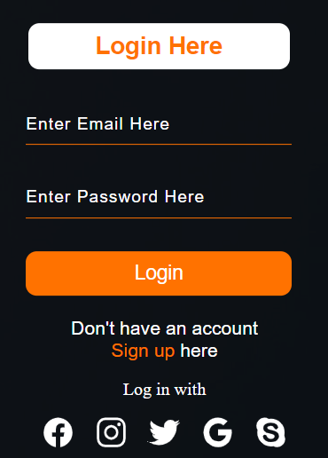
Login page
Once you open the website it asks you to “login” first,and for more options you can login with Facebook,Instagram,Twitter,Google and Skype.

Slide 5
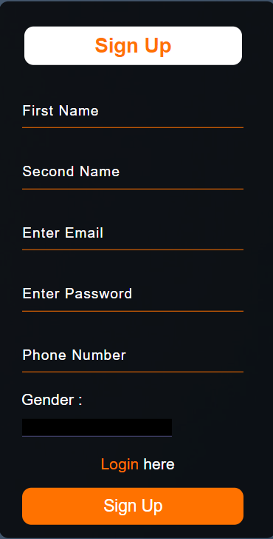
Sign up
And if you noticed, there is a “sign up” link that is used to create a new account on the website if you don’t have one.

Slide 6

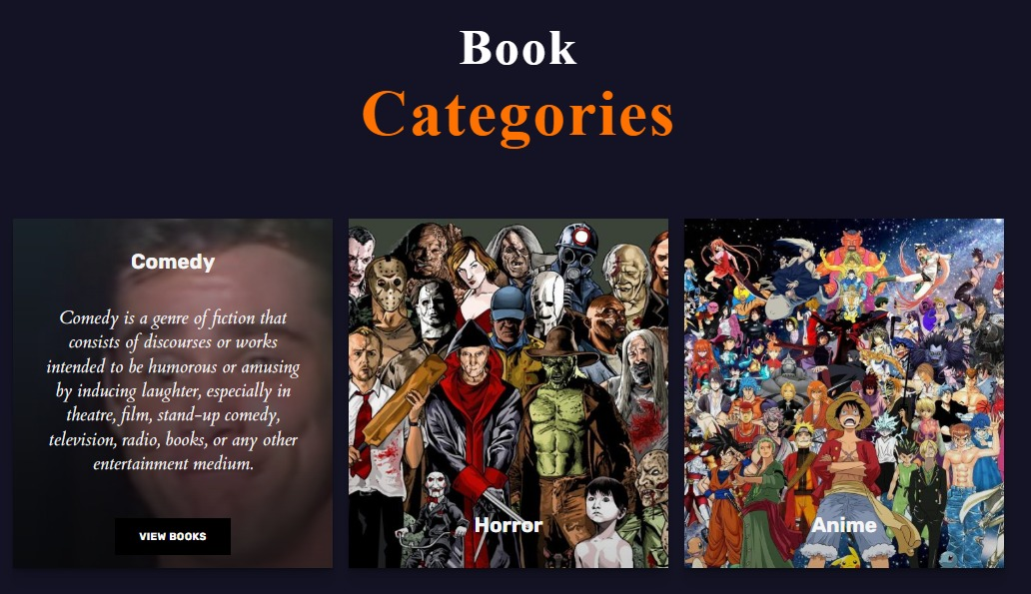
The Home page Our home page simply contains the book categories that gives the audience the option to select the type of books they want to read or get any information about.

Slide 7

Finally, the main role of the website which is rating books out of five stars and reviewing summarized paragraph that shows a brief meaning of the book. By clicking “Buy now” that will take you to an online store that sells the chosen book.

Slide 8



OUR TEAM
Youssef Soltan
Ziad Abdelkader
Esmail Ahmed

Slide 9



THIS IS OUR TEAM
Sama Nabil
Youssef Hany
Amir Mohamed

Slide 10
THANK YOU!
Book_review @gmail.com
555-111-222
bookreview.com
DON’T FORGET TO VISIT US.

